Slide 1
Linear Regression with One Variable
Linear Regression Model part 1

Slide 2
Content
Linear Regression Model
The process of supervised learning
Cost function
Intution of cost function
Visualizing the cost function

Slide 3
House sizes and prices
price in
$1000's
300
200
100
0
1000
size in feet²
0
2000
3000
Supervised learning model
Data has “right answers”
Regression model Predicts numbers Infinitely many possible outputs

Slide 4
House sizes and prices
500
linear regression
400
price in
$1000's
300
220 K
each data point
is a house size
with the price
200
100
0
1000
size in feet²
0
1250
2000
3000
Supervised learning model
Data has “right answers”
Regression model Predicts numbers Infinitely many possible outputs

Slide 5
Example of Linear Regression Model: House price vs. Size
From data set into Regression model
price in $1000's
Data table
size in feet² price in $1000's
500
400
2104
1416
1534
852
…
3210
400
232
315
178
…
870
300
200
100
0
0
1000
2000
size in feet²
3000

Slide 6
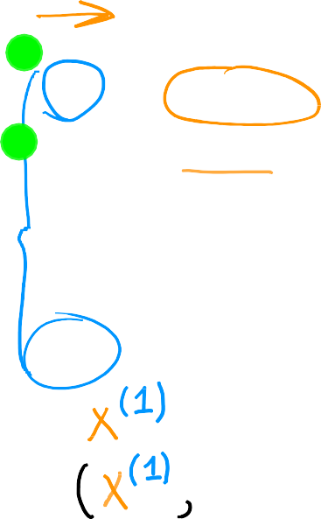




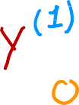



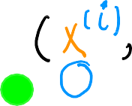











Terminology
Notation:
𝑥 = “input” variable.
feature
𝑦 = “output” variable
“target” variable
𝑚 = number of training examples
Training Set: Data used to train the model
𝑥
𝑦
price in $1000's
size in feet²
(1)
(2)
(3)
(4)
…
(47)
2104
1416
1534
852
…
3210
400
232
315
178
…
870
= single training example
(𝑥^{(i)}, 𝑦^{(i)}) = i^{th} training example
index
not exponent
(1st, 2nd, 3rd …)
𝑥⁽²⁾ = 1416

Slide 7
The process of supervised learning

Slide 8



The process of supervised learning
training set
(Features, Targets)
Fed to
learning algorithm
Generates
“y-hat”
𝑦^
𝑥
ƒ
feature
model
prediction (estimated 𝑦)
Size (feets^2) → Model → estimated price y
Andrew Ng

Slide 9
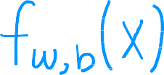




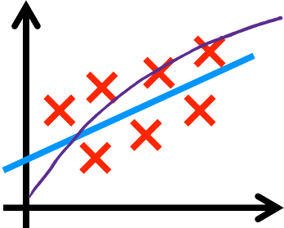







How to represent ƒ?
w: slope
b: y-intercept
Since we have a linear regression f will be linear equation
can simply written as
𝑥 = 𝑤𝑥 + 𝑏 ƒ 𝑥 = 𝑤𝑥 + 𝑏
None linear Model
^{ƒ}w,𝑏
Y = w1x^2 + w2X + b
𝑦
The regression mahine
learning
task is to find the values
of w and b
𝑥
Linear regression with one variable.
Univariate linear regression.

Slide 10
Linear Regression with one variable
Cost Function
One of the most important concepts in machine learning

Slide 11
What is cost function
In linear regression, the cost function is a measure of how well the model's predictions fit the observed data. It is a way to quantify the error between the predicted values and the actual values. The cost function is typically minimized during the training process, in order to find the best values for the model's parameters.
We need a cost function because it allows us to measure the performance of our model. Without a cost function, we would have no way to know how well our model is fitting the data. This would make it difficult to improve our model and make accurate predictions.

Slide 12


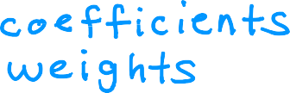
Training set
size in feet² (𝑥)
price $1000's (𝑦)
Model: ƒ_{w,𝑏} 𝑥 = 𝑤𝑥 + 𝑏
𝑤, 𝑏: parameters
2104 | 460
1416 | 232
1534 | 315
852 | 178
What do 𝑤, 𝑏 do?
Parameters are the variables we keep
changing to train the model

Slide 13
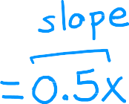







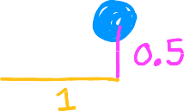

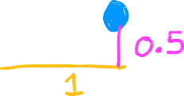











^{ƒ}w,𝑏
𝑥 = 𝑤𝑥 + 𝑏
How w and b affect the shape of the function f
ƒ(𝑥)
3
3
3
2
2
2
1
1
1
0
0
0
1 2
𝑤 = 0
𝑏 = 1.5
1 2
𝑤 = 0.5
b = 0
1 2
𝑤 = 0.5
𝑏 = 1
0
3
0
3
0
3

Slide 14





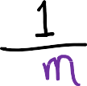
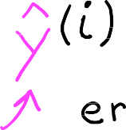


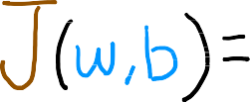










Cost function: Squared error cost function
y
_{(𝑥}(i)_{, 𝑦}(i)₎
Find 𝑤, 𝑏:
𝑦^^{(i)} is close to 𝑦^{(i)} for all (𝑥 ^{i} , 𝑦^{(i)}).
^{ƒ}w,𝑏
x
m = number of training examples
𝑦^^{(i)} = ƒ_{w,𝑏}
_{𝑥} i
_{𝑥} i
^{ƒ}w,𝑏
= 𝑤𝑥^{(i)} + 𝑏

Slide 15
Linear regression with one variable
Intution of cost function
This part will show how the cost function can be used to find the best parameters for the model

Slide 16





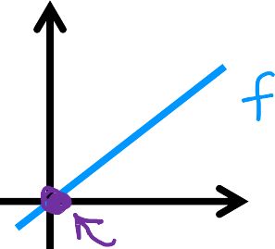








model:
simplified
ƒ_{w} 𝑥 = 𝑤𝑥
^{ƒ}w,𝑏
𝑥 = 𝑤𝑥 + 𝑏
parameters:
𝑤, 𝑏
cost function:
goal:
minimize 𝐽 𝑤, 𝑏
w,𝑏
minimize 𝐽 𝑤
w

Slide 17







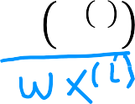


ƒ_{w}(𝑥)
(for fixed w, function of 𝑥)
input
𝐽(𝑤)
(function of 𝑤)
parameter
3
ƒ_{w}
3
2
y
1
0
2
𝑤 = 1
𝐽(𝑤)
1
0
0
1
1
x
_{𝑥} i
2
3
-0.5 0 0.5 1 1.5 2 2.5
𝑤
𝑚
𝑚
1
∑(𝑤𝑥 ^{i} − 𝑦 ^{i} )²
i=1
1
𝐽(𝑤) =
∑(ƒ
− 𝑦 ^{i} )² =
= ( 0² +0² +0² ) = 0
2𝑚
w
2𝑚
2𝑚
i=1

Slide 18
𝐽(𝑤)
(function of 𝑤)
parameter
3
ƒ_{w}
3
2
y
1
0
2
𝐽(𝑤)
1
0
0
1
1
x
_{𝑥} i
2
3
-0.5 0 0.5 1 1.5 2 2.5
𝑤
𝑚
𝑚
1
∑(𝑤𝑥 ^{i} − 𝑦 ^{i} )²
i=1
1
∑(ƒ
− 𝑦 ^{i} )² =
= ( 0² +0² +0² ) = 0
2𝑚
w
2𝑚
2𝑚
i=1

Slide 19






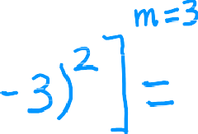
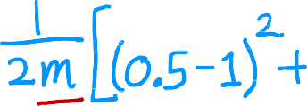
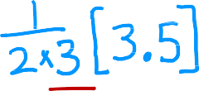






ƒ_{w}(𝑥)
(function of 𝑥)
𝐽(𝑤)
(function of 𝑤)
3
ƒ_{w}(𝑥)
3
2
2
y
𝐽(𝑤₁)
1
1
𝑤 = 0.5
0
0
0
1
2
3
-0.5
0 0.5 1 1.5 2 2.5
𝑤
x
𝐽 0.5 =

Slide 20







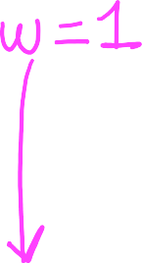



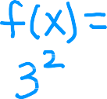


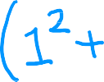







ƒ_{w}(𝑥)
(function of 𝑥)
𝐽(𝑤)
(function of 𝑤)
3
ƒ_{w}
3
2
2
y
𝐽(𝑤)
1
1
𝑤 = 0
0
0
0
1
2
3
-0.5
0 0.5 1 1.5 2 2.5
𝑤
x
𝐽 0 =

Slide 21



goal of linear regression:
𝐽(𝑤)
(function of 𝑤)
3
2
minimize 𝐽 𝑤
w
general case:
minimize 𝐽 𝑤, 𝑏
w,𝑏
𝐽(𝑤)
1
0
-0.5
0 0.5 1 1.5 2 2.5
𝑤

Slide 22
Linear Regression with 1 variable
Visualizing the Cost Function

Slide 23


𝑥 = 𝑤𝑥 + 𝑏
This is what we have seen so far
Model
^{ƒ}w,𝑏
Parameters
𝑤, 𝑏
Cost Function
Objective
minimize 𝐽 𝑤, 𝑏
w,𝑏

Slide 24
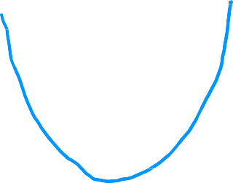





^{ƒ}w,𝑏
𝐽
(function of 𝑥)
(function of 𝑤, 𝑏)
500
400
300
price in
$1000's
200
100
0
0
1000 2000
size in feet²
3000
But we don’t have w alone, but w and b
^{ƒ}w,𝑏
𝑥 = 0.06𝑥 + 50
this is a bad model ... why?

Slide 25
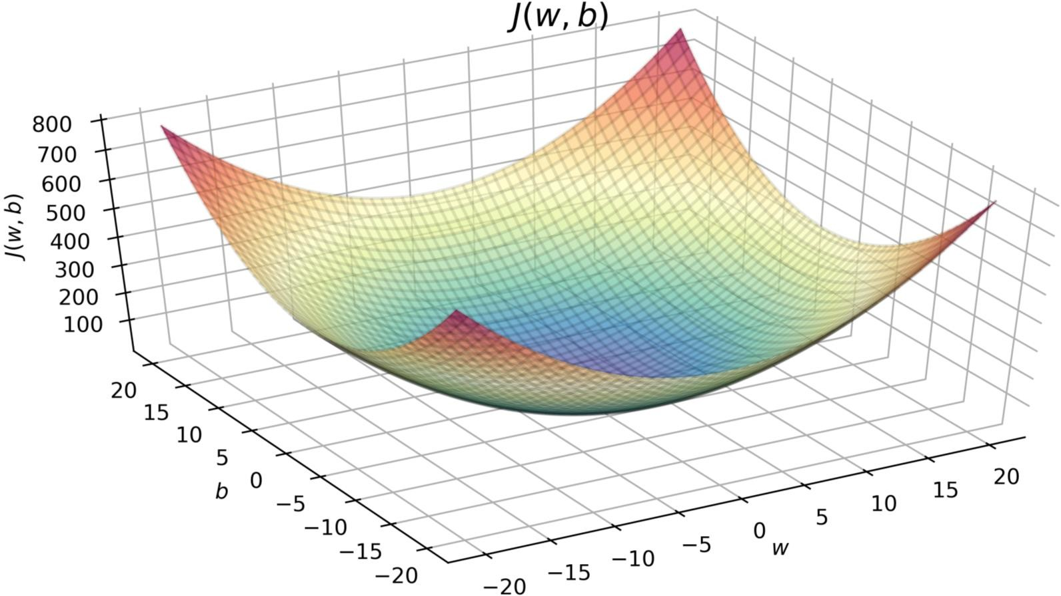
we have different
values for w and b
𝐽 w = −10, 𝑏 = −15
any single point on this curve
represents a pair of value for
w and b

Slide 26

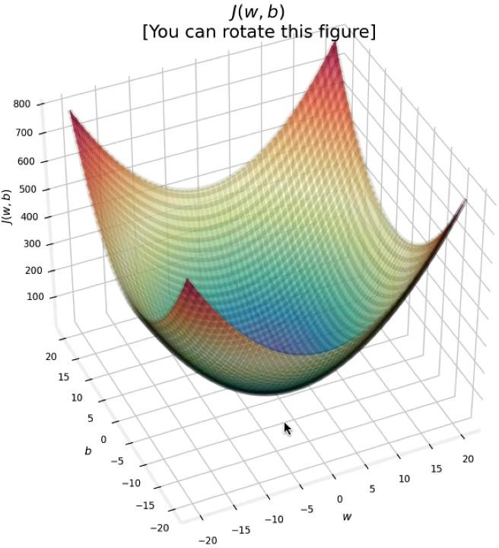


3D surface plot

Slide 27


Slide 28
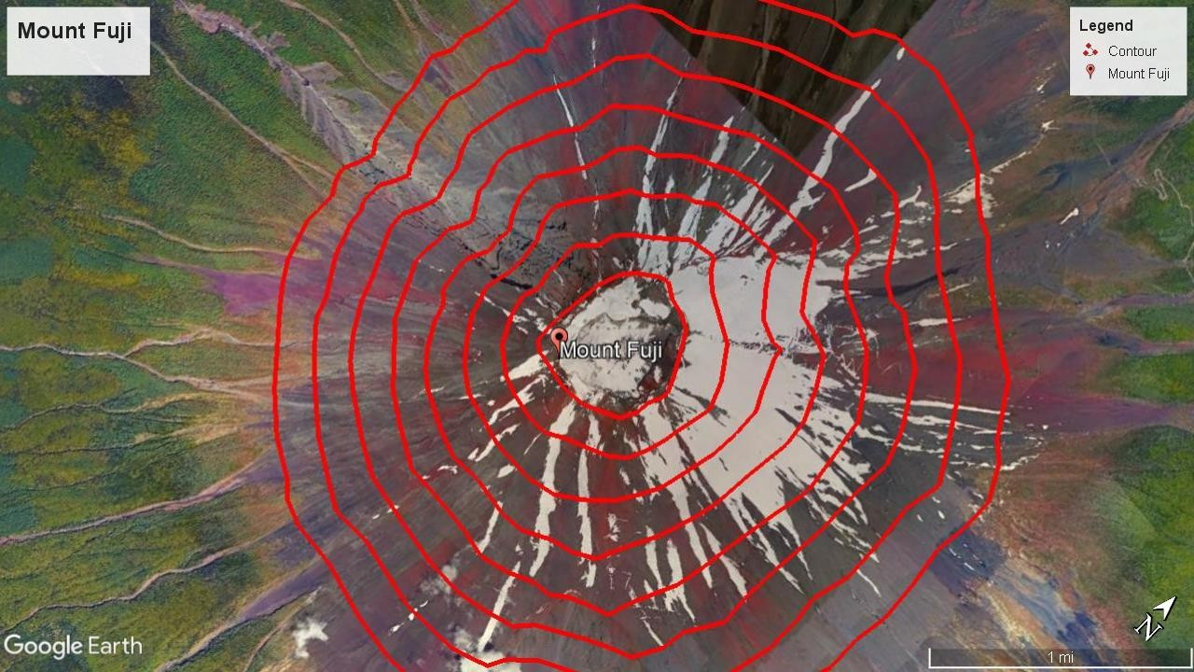

Slide 29
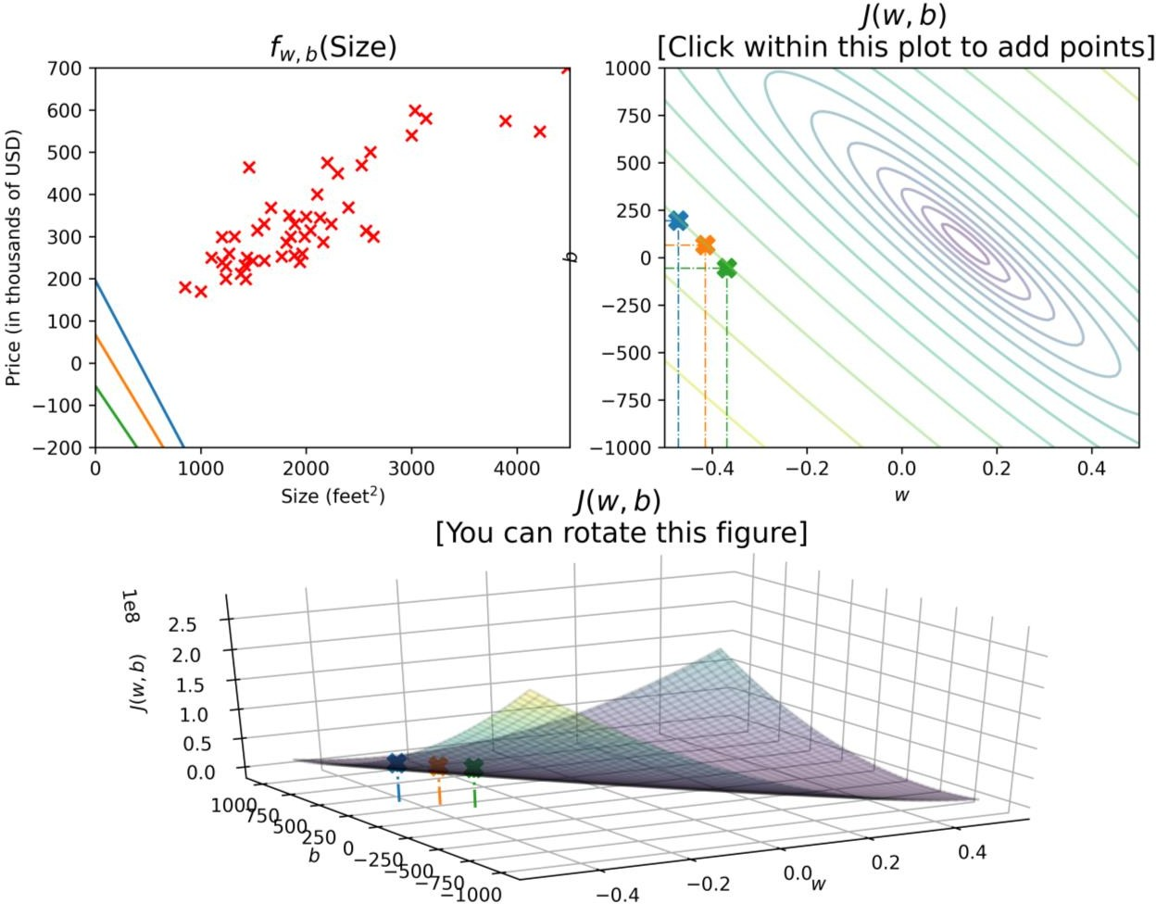






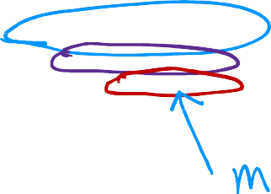


pric e in
$1000's

Slide 30
Linear Regression with 1 variable
Visualization examples

Slide 31
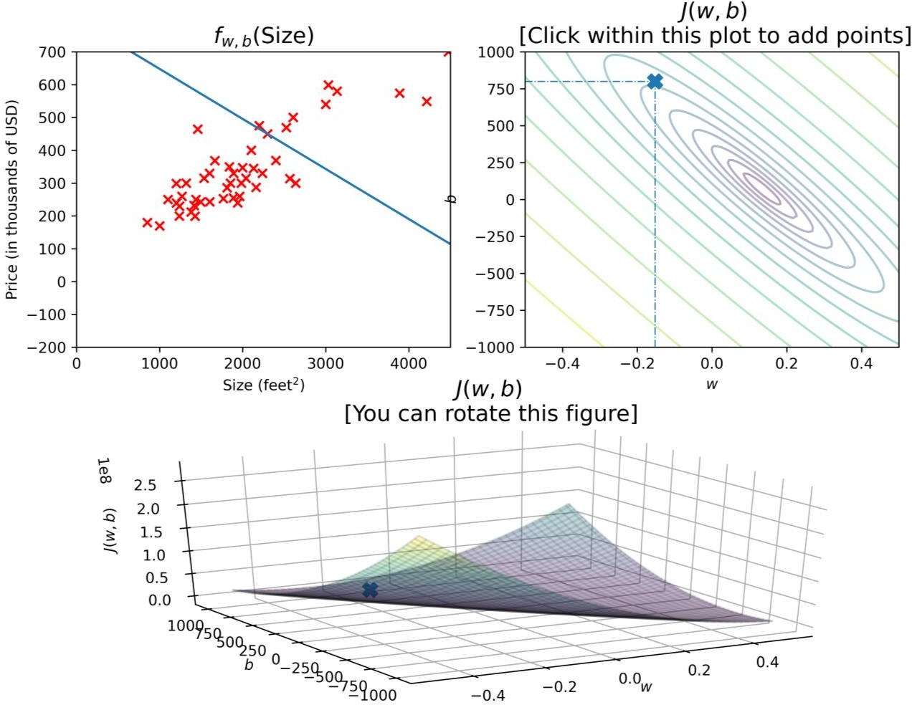


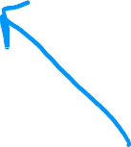





click within this plot to add points
pric e in
$1000's
size in feet²
 | you can rotate this figure

Slide 32
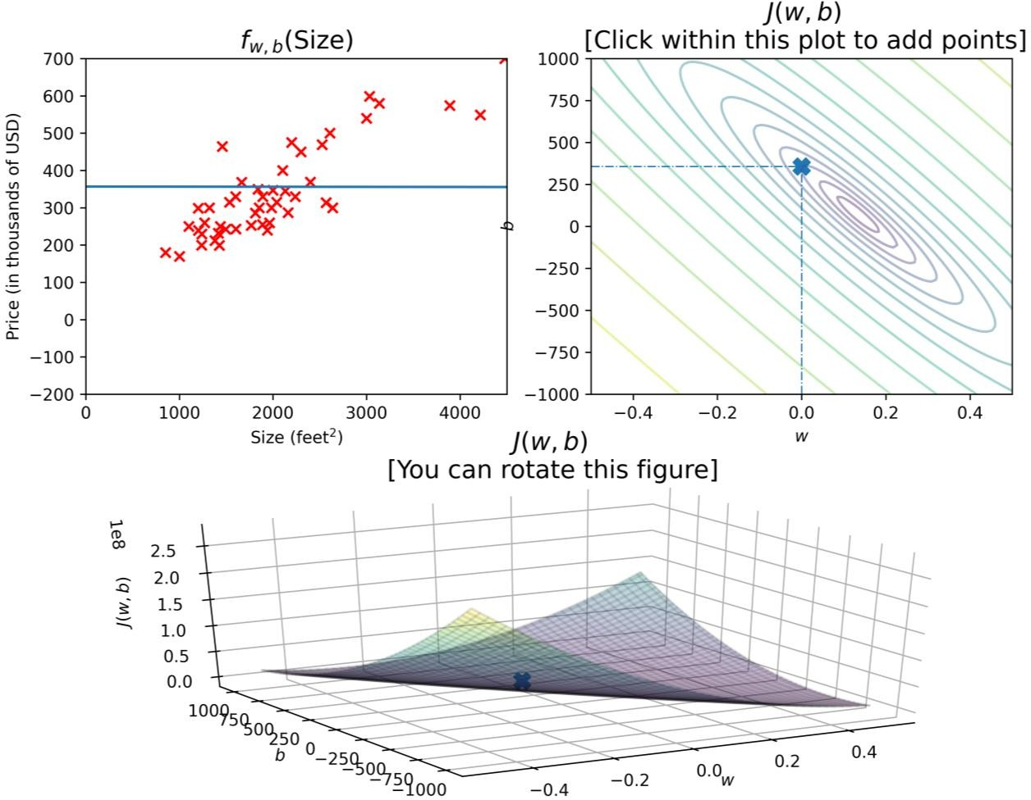




click within this plot to add points
pric e in
$1000's
size in feet²
 | you can rotate this figure

Slide 33
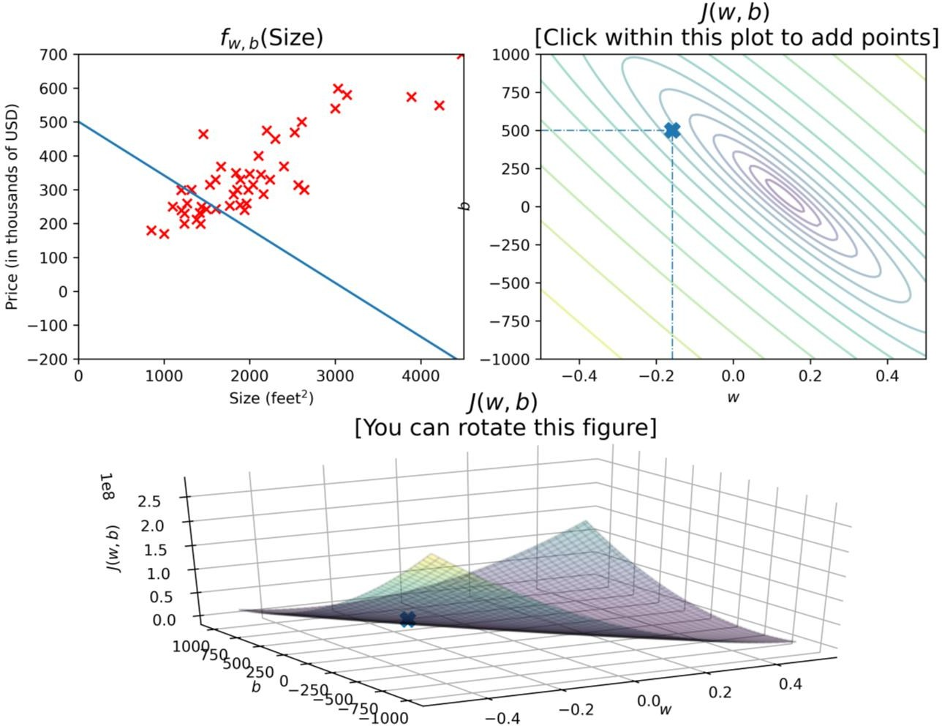



click within this plot to add points
pric e in
$1000's

Slide 34
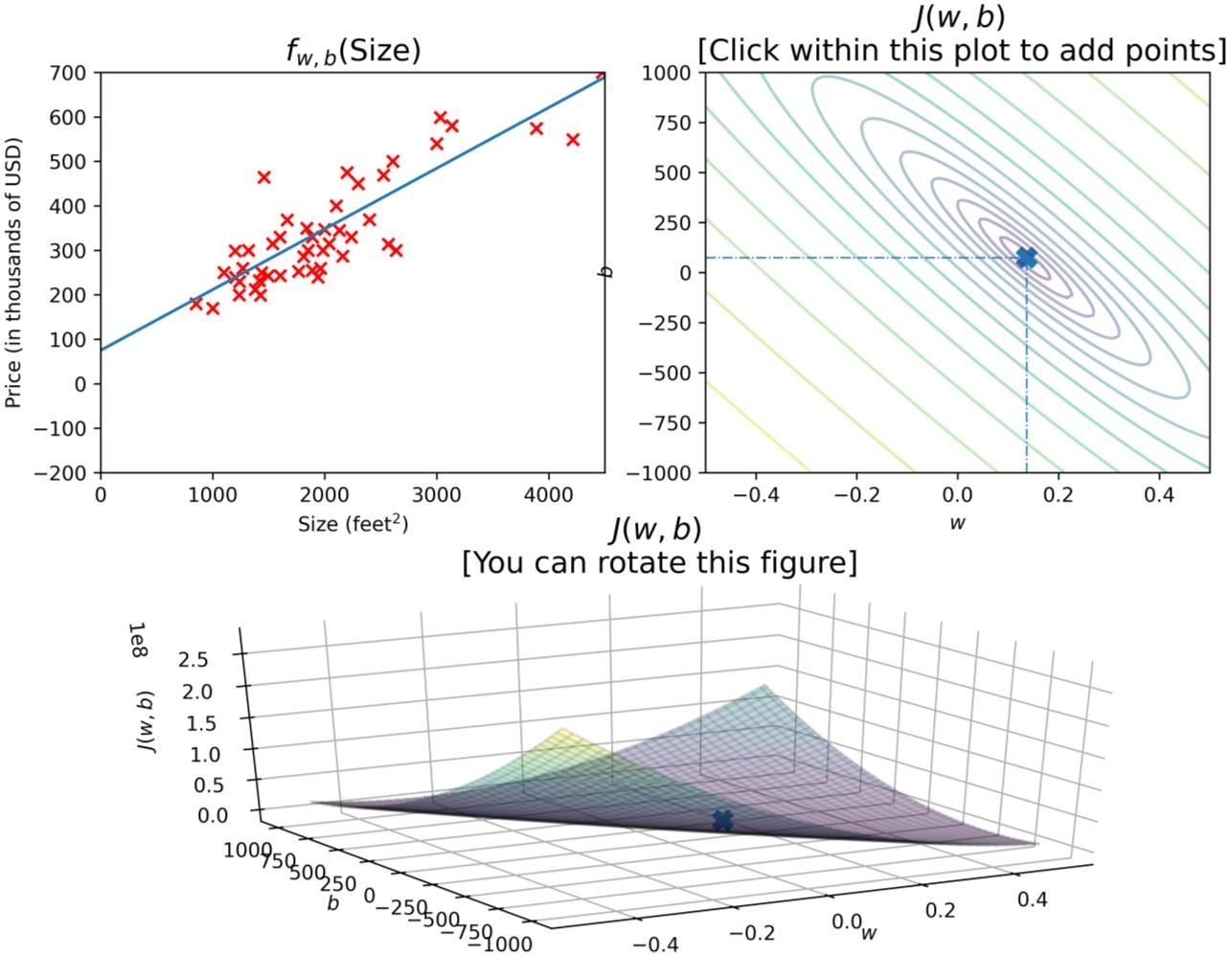






pric e in
$1000's

Slide 35
mean +/- stdev mean = 70
stdev = 10
70 – 10 = 60
70+ 10 = 80

